Slide 1



NOW FULLY CCMC APPROVED IN CANADA
FOR USE OVER LIVING SPACE (IE. SUNDECKS & FLAT ROOFS)

Slide 2
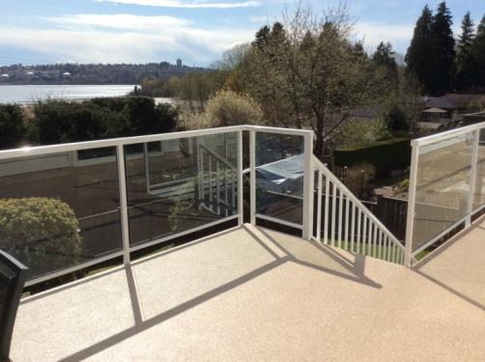
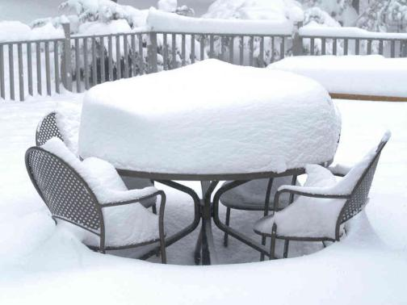
AGENDA
FLEXSTONE OVERVIEW
FLEXSTONE APPLICATIONS
APPLICATION PROCESS
ADVANTAGES
CCMC APPROVALS
CONCLUSION

Slide 3

FLEXSTONE OVERVIEW (1/2)
FLEXSTONE is a unique water-catalyzed polyurethane coating
FLEXSTONE is the only seamless coating with CCMC approvals
FLEXSTONE is seamless | odorless | 3-times thicker than competing urethanes
FLEXSTONE is a combination of a base coat + finish coat(s)
FLEXSTONE is versatile and long lasting
FLEXSTONE is applicable over existing membranes
FLEXSTONE is cost-effective and eco-friendly
FLEXSTONE does not require reinforcing fabrics or scrims
FLEXSTONE is designed for extreme heat and extreme cold
NO REINFORCING FABRIC OR SCRIM REQUIRED

Slide 4
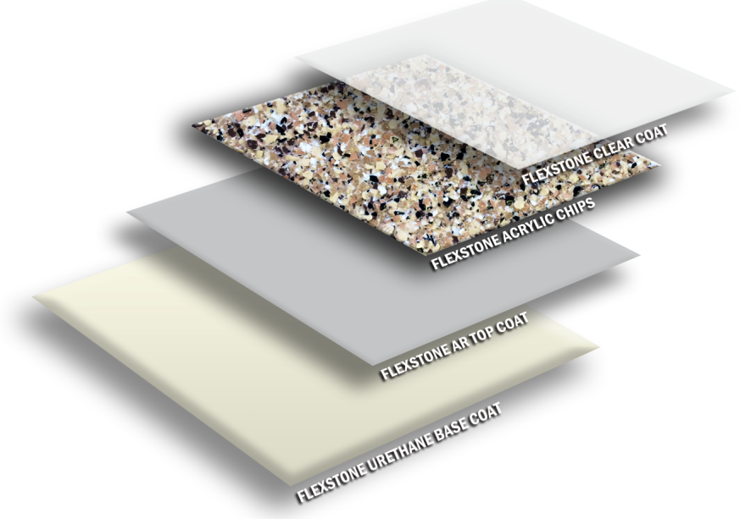
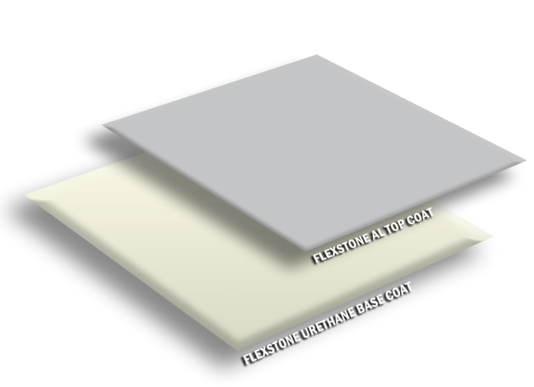
FLEXSTONE OVERVIEW (2/2)
STANDARD COLOUR COAT
PRODUCT COMPONENTS
TEXTURED STONE FINISH
PRODUCT COMPONENTS

Slide 5
FLEXSTONE APPLICATIONS
SUNDECKS, PATIOS, & WALKWAYS
FLAT ROOFS AND ROOF DECKS
SUSPENDED SLABS
VEHICLE PARKADES
POOL & HOT TUB SURROUNDS
GARAGE & INDUSTRIAL FLOORS
OVER OR UNDER TILES
AND MORE…
WE CAN COAT:
Plywood, concrete, existing vinyl, fiberglass, torch-on roofing, tiles, old urethanes, exposed aggregate, and much more...

Slide 6
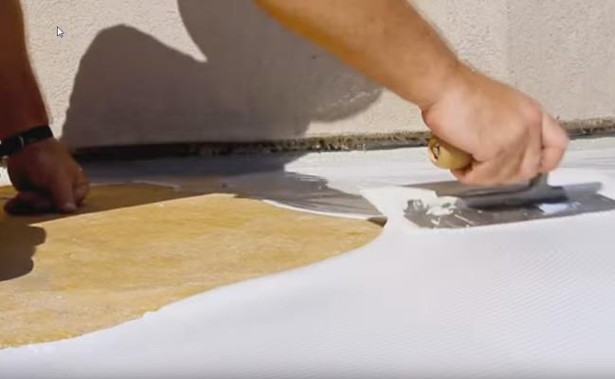
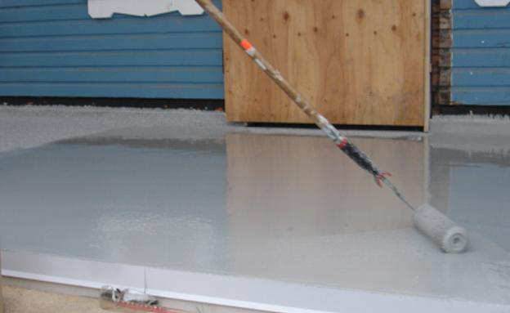
APPLICATION PROCESS
STANDARD COLOUR FINISH
2 Steps: Eco-friendly Base & Coloured Top Coat
Colour coat and base coat accelerators are available to speed-up the curing process when questionable weather is forecasted.
1
STEP 1 - APPLY FLEXSTONE/TUFFLEX WATER- CATALYZED URETHANE BASE COAT
Standard plywood is ideal. For surfaces that may lead to questionable adhesion or potential blistering (ie. Concrete or tiles), Flexstone’s 2 part Epoxy Primer / Sealer (#2 Primer) is available.
STEP 2 - APPLY FLEXSTONE / TUFFLEX ALIPHATIC COLOUR COAT, BACK-ROLL FINE SILICA SAND FOR SLIP RESISTANCE

Slide 7

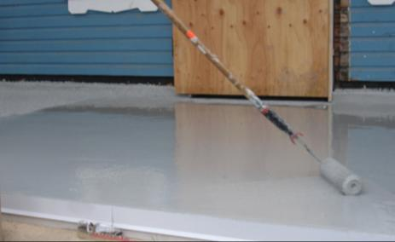
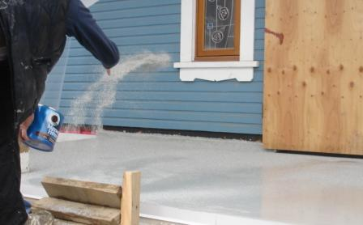
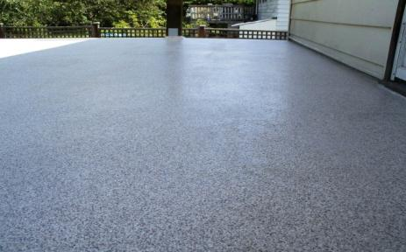
APPLICATION PROCESS
TEXTURED STONE FINISH
4 Steps: Eco-friendly Base / Colour Top Coat / Acrylic Chips / Aliphatic Clear Coat
STEP 1 - APPLY FLEXSTONE/TUFFLEX WATER- CATALYZED URETHANE BASE COAT
STEP 2A - APPLY FLEXSTONE / TUFFLEX AROMATIC COLOUR COAT
STEP 2B – BROADCAST FIRE-RETARDANT CHIPS INTO WET COLOUR COAT
STEP 3 – SWEEP / SAND SURFACE AND EVENLY ROLL OUT ALIPHATIC CLEAR COAT.

Slide 8
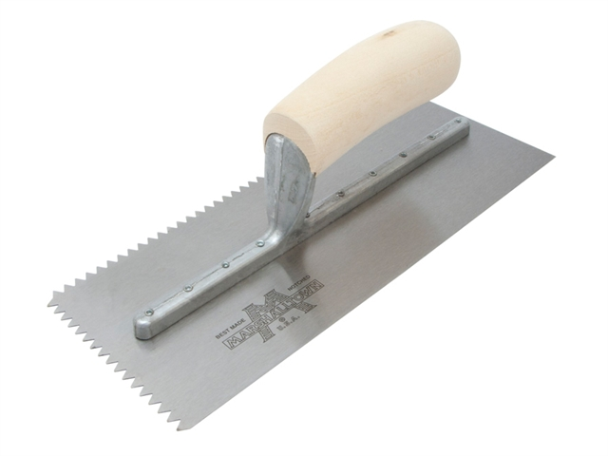
APPLICATION PROCESS
CONTROL OVER APPLICATION PROCESS & PRODUCT THICKNESS
FOLLOWING MANUFATURER’S SPECIFICATIONS
GAUGE RAKES:
V-NOTCHED TROWELS:
Certified Flexstone applicators are thoroughly trained to ensure consistent thickness & quality regardless of applicators.

Slide 9
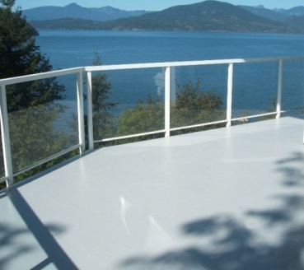
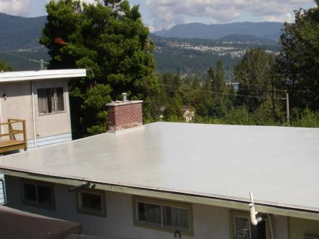
FLEXSTONE ADVANTAGES
CCMC approved (same tests as SBS roofing)
Performs in freezing or scorching hot climates
Scratch & puncture resistance
Seamless and luxurious
100% UV Stable & fade resistant
Versatile and long lasting
Easy to apply
Applicable over old membranes
Eco friendly (cold applied)
Affordable

Slide 10

CCMC APPROVALS
CCMC APPROVAL NUMBER: 13473-R
November 2014 – Flexstone Coatings received full CCMC approvals
APPROVED FOR:
Waterproofing over living space:
  Flat Roofs
  Sundecks
  Suspended slabs
  Roof Decks

Slide 11
CCMC TEST HIGHLIGHTS
TENSILE STRENGTH
  Min Requirements: 1.86 FS = 2.92 (57% greater than min requirement)
TEAR RESISTANCE
  Min Requirements: 5.8 FS = 10 (72% higher than min requirement)
DYNAMIC IMPACT / PUNCTURE RESISTANCE
  Min Requirements: 20 out of 24 samples > or = to 9 Rating (FS = 24 of 24 achieved a rating of 23)
ELONGATION OF BASE
  364 % using CCMC test procedures
PEEL ADHESION ON PLYWOOD
  Min Requirements: 525, FS = 1303 (148% higher than min)
CRACK BRIDGING BEFORE AND AFTER HEAT AGING
  Tests showed no evidence of cracking, splitting or loss of adhesion

Slide 12
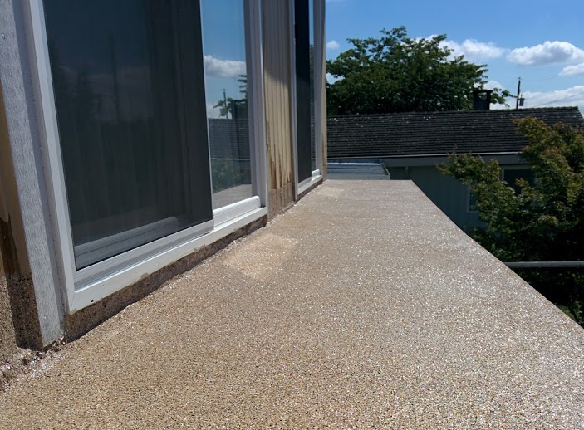
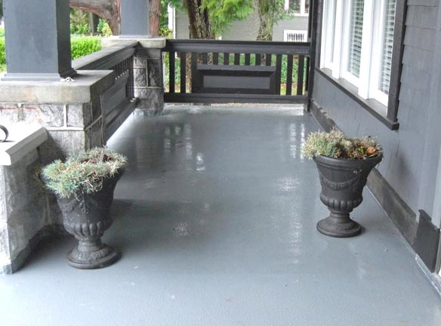
SUMMARY
WHAT IS FLEXSTONE?
ENDLESS APPLICATIONS
SIMPLE APPLICATION PROCESS
MULTITUDE OF ADVANTAGES
FULL CCMC APPROVALS

Slide 13

THANK YOU.
www.flexstoneontario.com
PHONE: 1 (905) 993-1330
TOLL FREE: 1 (888) 993-1330
WEB: www.flexstoneontario.com
EMAIL: contact@flexstoneontario.com

